Slide 1
Amplitudes from photo-production data (with minimal model input)
Ron Workman

Slide 2
Amplitude reconstruction
Need 8 (or more) Observables → H or b set
Multipole analysis
Schematically M_{L} ≈ ∫ H e^{i φ(E,ϴ)} P_{L} (x) dx
Need theory input at this stage
More theory input → fewer required observables?
Isospin decomposition ?
Consider πN scattering and photo-production

Slide 3
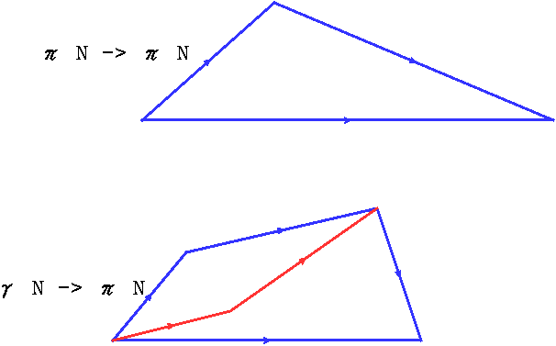
Phases and isospin
π⁻p + √2 π⁰n = π⁺p
3 charge channels
2 isospin states
(triangle relation)
4 charge channels
3 isospin states
(quadrilateral relation)
√2 π⁰n + π⁺n + π⁻p = √2 π⁰p

Slide 4
Fixing overall phases
π⁰p
π ⁺n phase fixed
[ by ‘known’ high-L part (real) ]
I=3/2
π⁺n
Grushin method:

Slide 5
I=3/2
π⁺ n and π⁻ p phases fixed
π⁰ p
π⁰ n
π⁺ n
π⁻ p

Slide 6
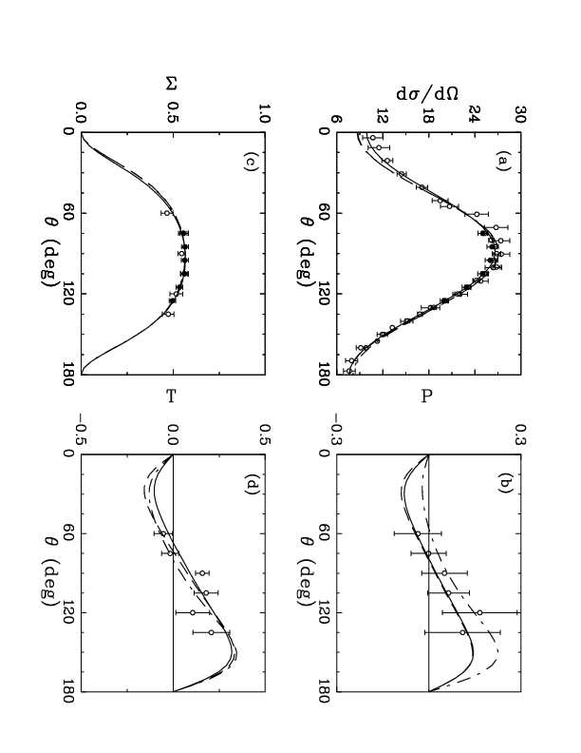
Grushin Fits to π⁰p data at 350 MeV
L ≥ 2
Fit L ≤ 1
Fix one phase

Slide 7
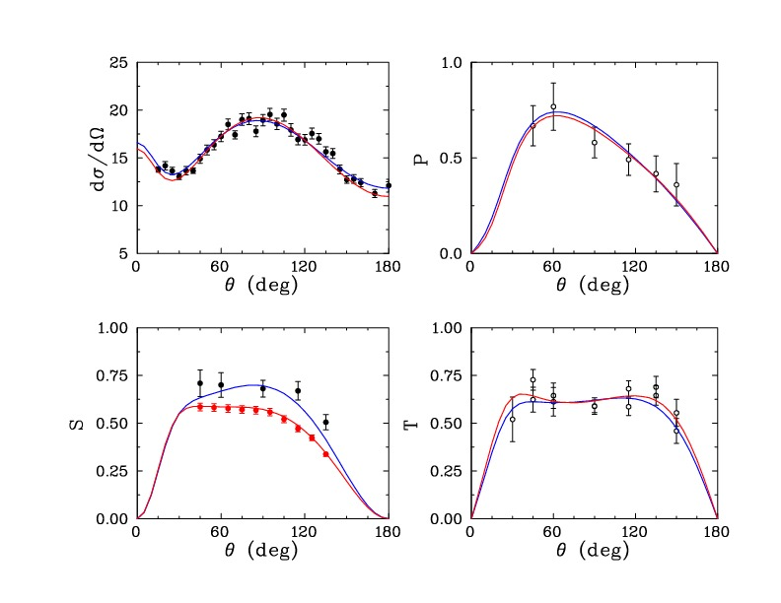
Grushin fit (blue) Re-fit (red) to π⁺ n at 340 MeV
Fit L ≤ 1
Born L≥ 2
Modified Grushin fit (blue) and Re-fit (red) at 340 MeV for π⁺n
Modified Grushin fit (blue) and Re-fit (red) at 340 MeV for π⁺n

Slide 8
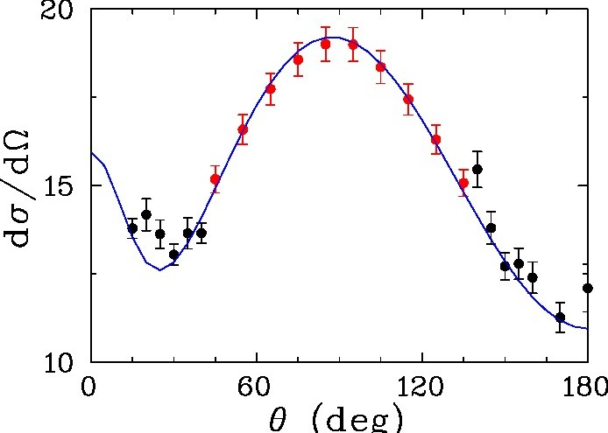
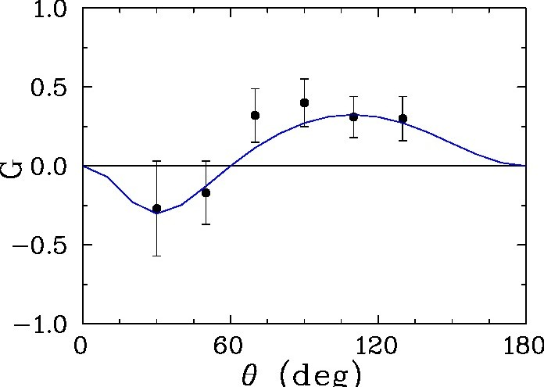
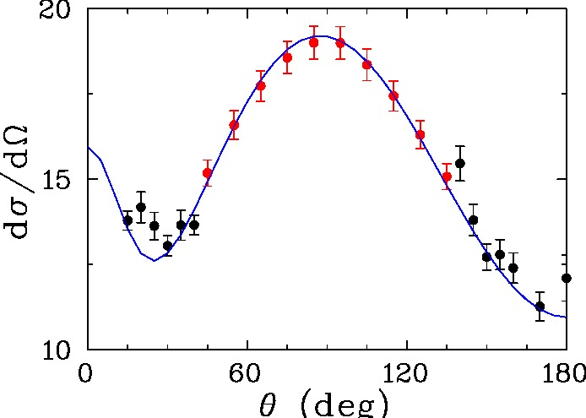
Fits/predictions of π⁺ n at 340 MeV
Fit (red) Predict (black)
Predict beam-target G

Slide 9
Omelaenko analysis of ambiguities
dσ/dΩ, P, Σ, T, E, H, O_{x} , C_{z} , T_{x} , L_{z} (no change)
Notes:
notes

Slide 10
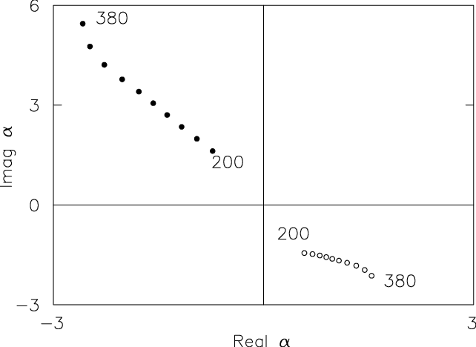
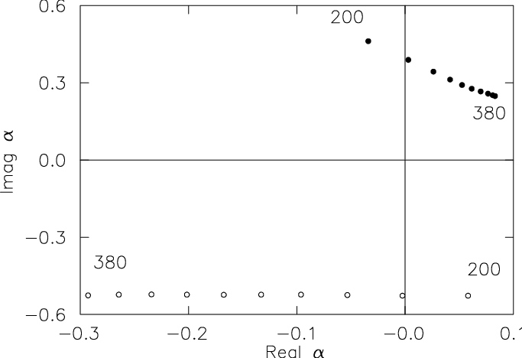
Low-energy zero trajectories (π⁰ p)
α : ●
β : o
(accidental symmetries give additional solutions)
[ see Omelaenko, Yad. Fiz. 34, 730 (1981) ]

Slide 11
Fits to π⁰ p data at 350 MeV
Fits 1, 2, and CRS are identical for dσ/dΩ, P, Σ, T data

Slide 12
Global (ED) versus Single-Energy (SE) Fits
● Generate pseudo-data (MD07)
● Fit with SAID ED form - generate SE fits
● Reproduce MD07 ?
Motivation
● Are SAID/MAID differences due to data issues?
● Are SE fits ‘equivalent’ to underlying datasets?

Slide 13
Towards a model independent PWA for pseudoscalar meson photoproduction
(more details in the plenary talk by Lothar Tiator)
Motivation
Complete Experiments
Pseudo Data
Complete Amplitude Analysis
Complete Truncated PWA
Summary and Conclusion
Lothar Tiator
Amplitude Analysis in Hadron Spectroscopy,
ECT* Workshop, Trento, January 24-28, 2011
Notes:
13

Slide 14
MD07 (red curve) Pseudo-data (black points) Real data (blue points) π⁰p at 320-340 MeV and comparison with real data

Slide 15
dσ/dΩ, P, Σ, T
Prediction compared to a fit of double-polarization observable
(sign issue)
E, F, G, H
O_{x} , O_{z} , C_{x} , C_{z}

Slide 16
Multipole: predicted vs input

Slide 17
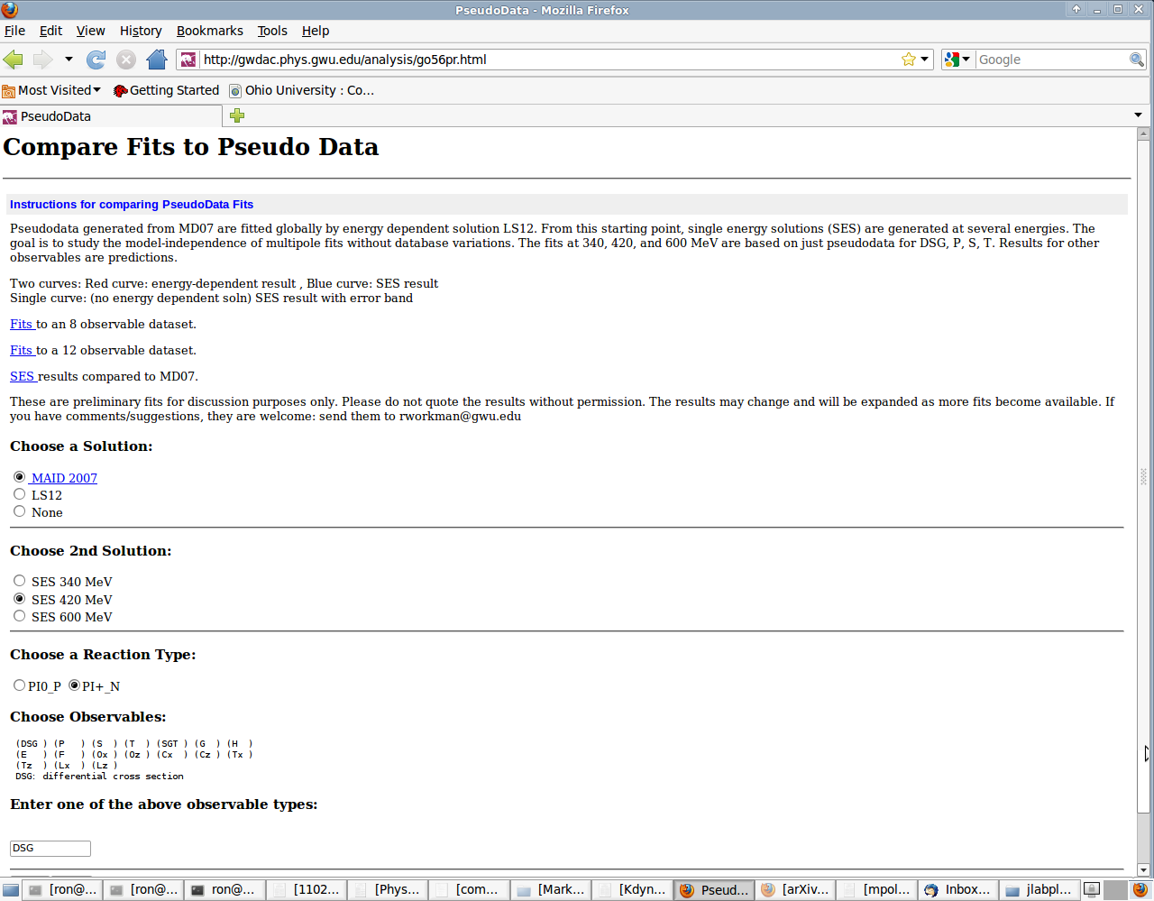

Slide 18
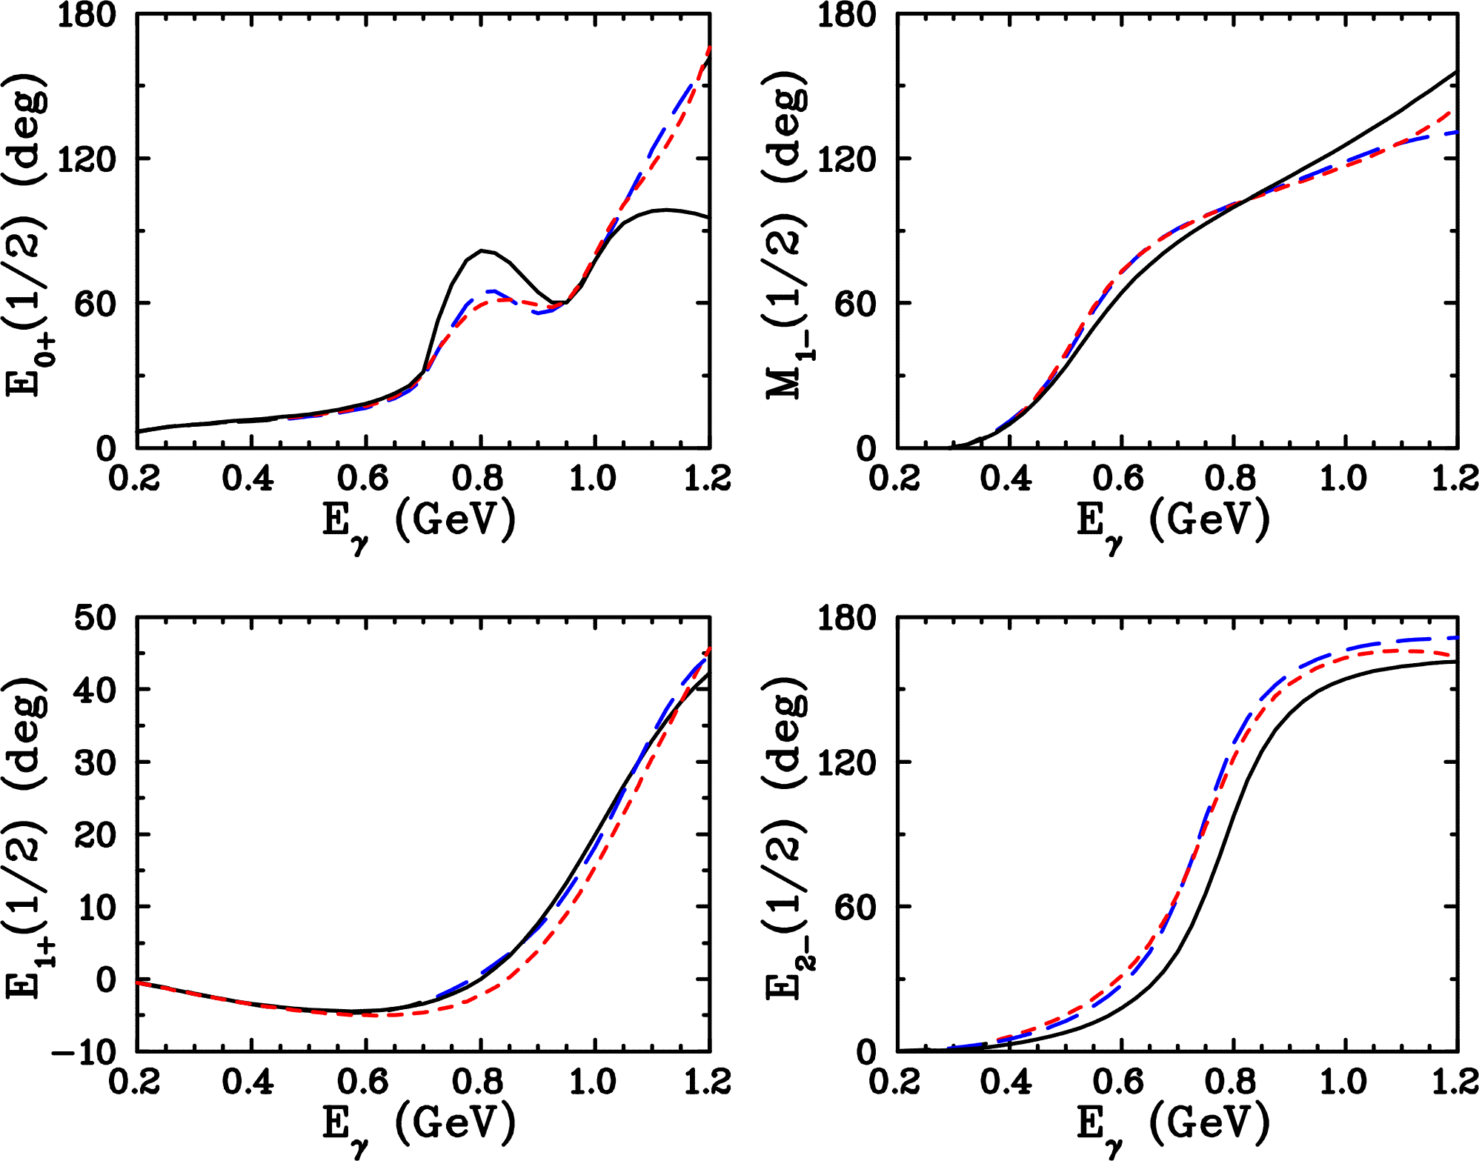
SAID vs MAID phase differences
SAID
MAID
ED fit

Slide 19
Effect of searching phases in SE fits

Slide 20
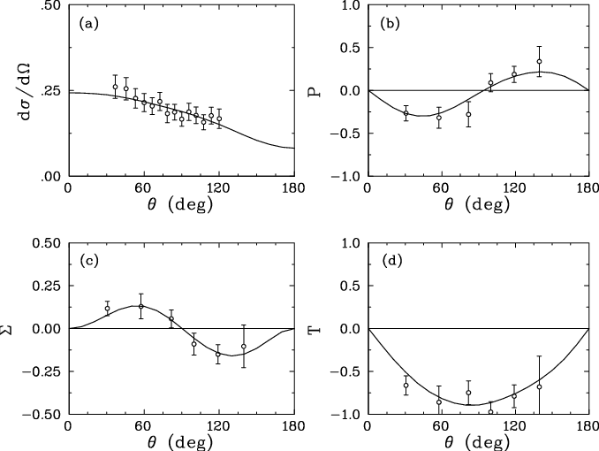
Fit to K⁺ Λ photo-production W=1680 MeV
( L<2 fit, L>1 Born [D₁₃ modified] )

Slide 21
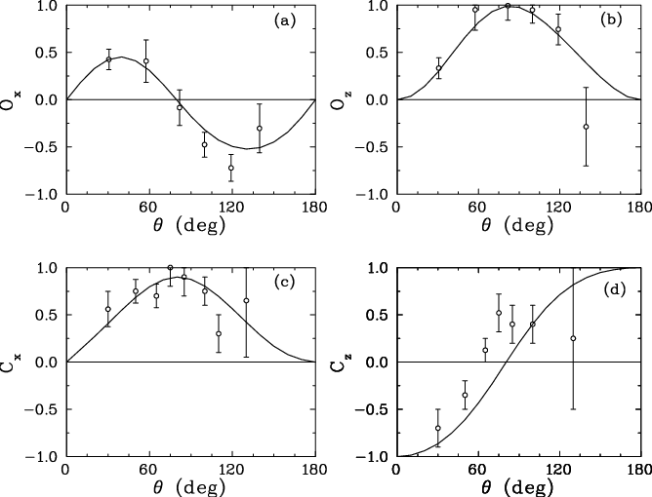
Fit O_{Z} - predict O_{X} , C_{X} , C_{Z}

Slide 22
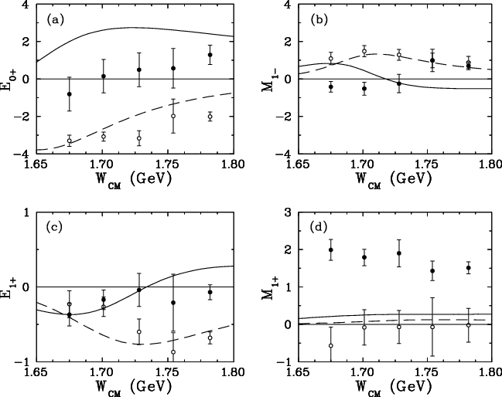
Multipoles compared to the Kaon MAID solution
Solid (real part)
Open (imag part)
(solution not unique)

Slide 23
Conclusions
● clarified the connection between ED and SE fits
● SAID is able to reproduce MAID amplitudes from data
(up to the second-resonance region)
● multipole fits/amplitude reconstructions require different
input from experiment and theory
● amplitude zeros (old method) may help to compare
fits (unitarity is a problem)
● kaon photoproduction results are mixed

Slide 24
